Slide 1
Interactive maps with leaflet
Chris Gettings
Senior Data Scientist, BESP

Slide 2
Everything is on GitHub
github.com/nychealth/talkR-leaflet-cgettings

Slide 3
Intro to leaflet
https://leafletjs.com/
“an open-source JavaScript library for mobile-friendly interactive maps”
leaflet R package: “An R Interface to Leaflet Maps”
https://rstudio.github.io/leaflet/
“Bindings” – R code calls custom JavaScript code, which uses Leaflet library functions

Slide 4
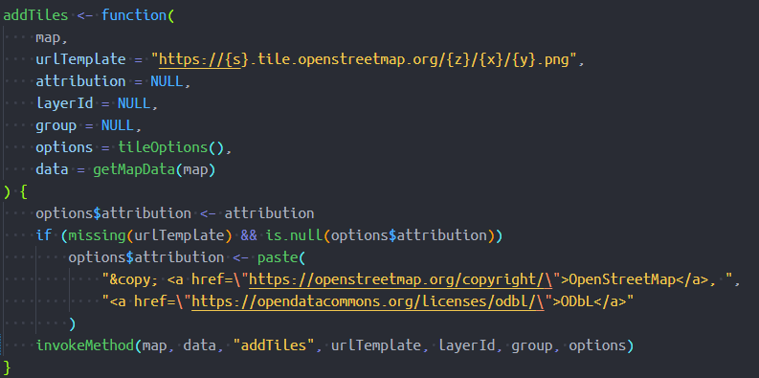

Intro to leaflet
addTiles()
source
source

Slide 5
Examples

Slide 6
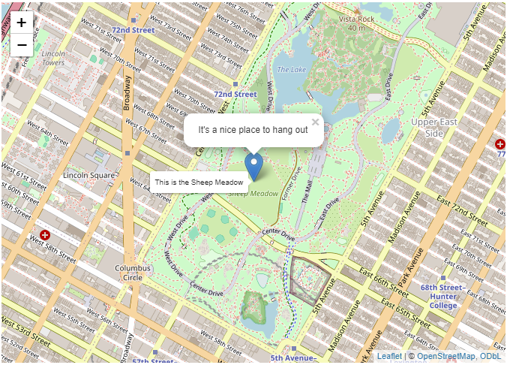
1. Basic
code/1-basic.Rmd

Slide 7
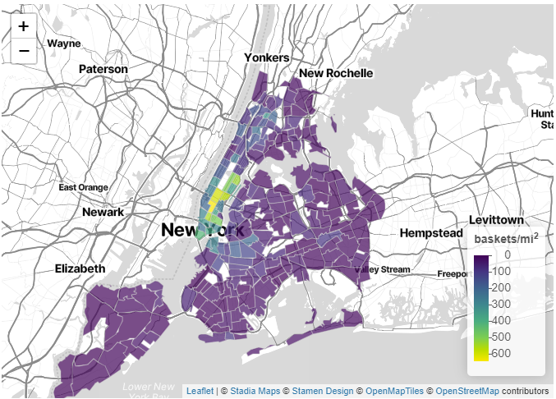
2. Choropleth - Intermediate
code/2-choropleth.Rmd

Slide 8
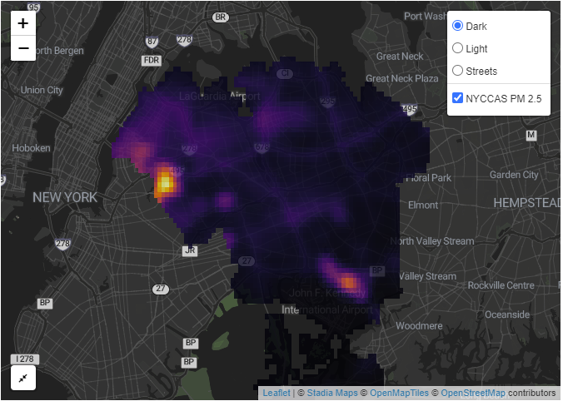
3. Raster - Advanced
code/3-raster.Rmd

Slide 9
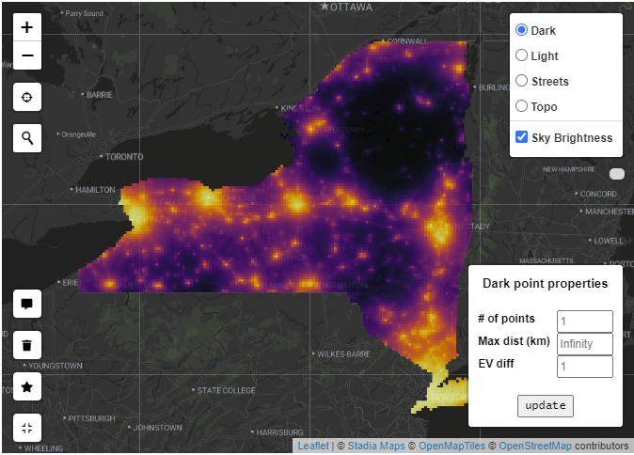
4. Light pollution - Very complicated
code/4-light_pollution.Rmd

